Slide 1
ATOMIC ENERGY EDUCATION SOCIETY
SUBJECT – GEOGRAPHY
STREAM – ARTS
CLASS -11th
CHAPTER-01 Geography as a Discipline
MODULE-01/02
Prepared By: Mr S.SADHUKHAN (PGT-SS)
AECS-2, JADUGUDA

Slide 2
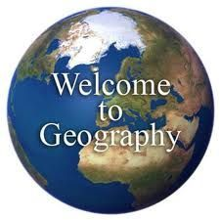

Slide 3
GEOGRAPHY
Geography is concerned with the description and explanation of the areal differentiation of the earth surface
Richard Hartshorne

Slide 4
Geography studies the differences of phenomena usually related in different parts of the earth’s surface.
Hettner

Slide 5
ERATOSTHENESE The term first coined by Greek Scholar
The word geography derived from Greek language
GEO -- EARTH
GRAPHOS -- DESCRIPTION
Geography is the description of the earth

Slide 6
GEOGRAPHY AS A DISCIPLINE IS CONCERNED WITH THREE SETS OF QUESTIONS
WHAT ?
WHERE ?
WHY ?

Slide 7
WHAT are the patterns of natural and cultural features found over the surface of the earth ?
WHERE are these features distributed over the surface of the earth ?
WHY such relationships between features, processes and phenomena take place?

Slide 8
Geography as an integrating discipline - spatial Synthesis
The shape of the earth is GEOID

Slide 9
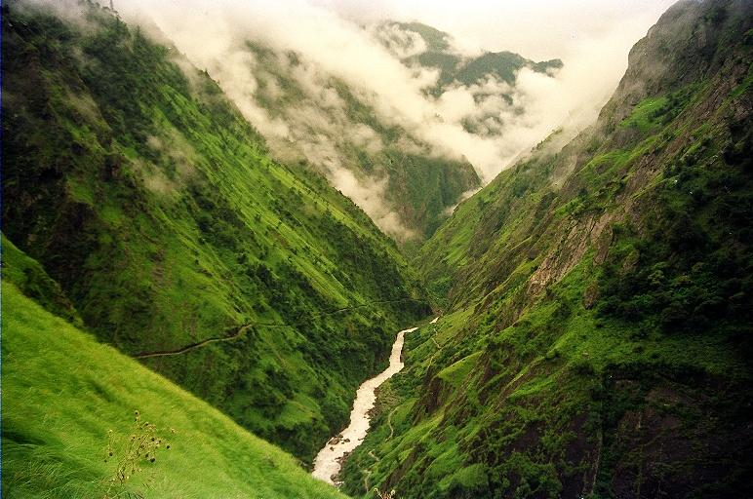

Slide 11
BRANCHES OF GEOGRAPHY
SYSTEMATIC APPROACH
Alexander von Humboldt (German)
systematic geography, concentrates on a specific geofactor at the global level
REGIONAL APPROACH
Karl Ritter (German)
It focuses on the interaction of different cultural and natural geofactors in a specific land or landscape

Slide 12
End of Module - 01
THANK YOU

